Slide 1
DMA CONTROLLER 8257

Slide 2
DMA CONTROLLER 8257
Features:
It is a 4-channel DMA.
So 4 I/O devices can be interfaced to DMA
It is designed by Intel
Each channel have 16-bit address and 14 bit counter
It provides chip priority resolver that resolves priority of channels in fixed or rotating mode.
It provide on chip channel inhibit logic.

Slide 3
It generates a TC signal to indicate the peripheral that the programmed number of data bytes have been transferred.
It generates MARK signal to indicate the peripheral that 128 bytes have been transferred.
It requires single phase clock.
The maximum frequency is 3Mhz and minimum frequency is 250 Hz.

Slide 4
It execute 3 DMA cycles
1.DMA read 2.DMA write 3.DMA verify.
It provide AEN signal that can be used to isolate CPU and other devices from the system bus.
It is operate in two modes.
1.Master Mode
2.Slave Mode

Slide 5
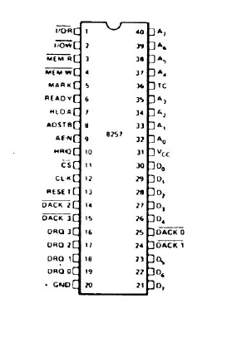
Pin Diagram of DMA controller

Slide 6
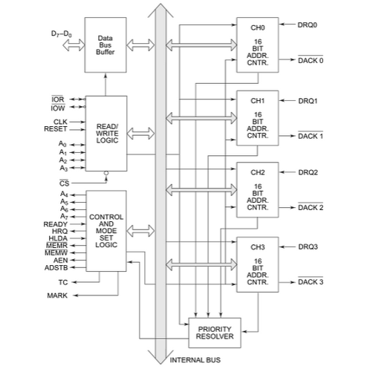
8257 BLOCK DIAGRAM

Slide 7
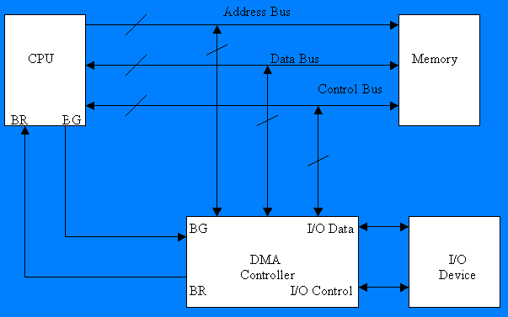

Slide 8
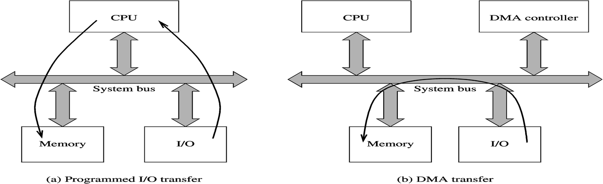

Slide 9
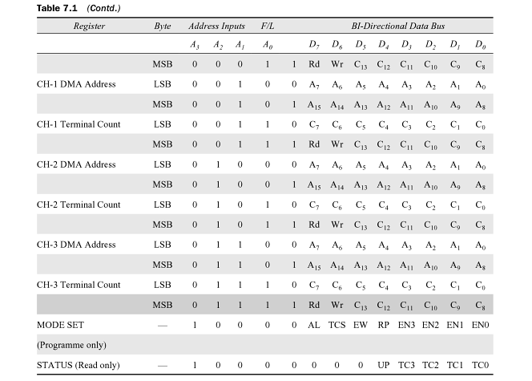
8257 Register selection

Slide 10
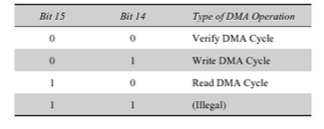
DMA Operation selection

Slide 11
Description
It containing Five main Blocks.
Data bus buffer
Read/Control logic
Control logic block
Priority resolver
DMA channels.

Slide 12
DATA BUS BUFFER:
It contain tristate ,8 bit bi-directional buffer.
Slave mode ,it transfer data between microprocessor and internal data bus.
Master mode ,the outputs A8-A15 bits of memory address on data lines (Unidirectional).
READ/CONTROL LOGIC:
It control all internal Read/Write operation.
Slave mode ,it accepts address bits and control signal from microprocessor.
Master mode ,it generate address bits and control signal.

Slide 13
Control logic block:
It contains ,
Control logic
Mode set register and
Status Register.
CONTROL LOGIC:
Master mode ,It control the sequence of DMA operation during all DMA cycles.
It generates address and control signals.
It increments 16 bit address and decrement 14 bit counter registers.
It activate a HRQ signal on DMA channel Request.
Slave ,mode it is disabled.

Slide 14
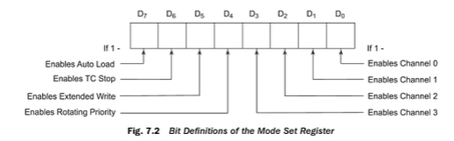
MODE SET REGISTERS:
It is a write only registers.
It is used to set the operating modes.
This registers is programmed after initialization of DMA channel.
D₇ | D₆ | D₅ | D₄ | D₃ | D₂ | D₁ | D₀
AL | TCS | EW | RP | EN₃ | EN₂ | EN₁ | EN₀

Slide 15
AL=1=Auto load mode
AL=0=Rotating mode
TCS=1=Stop after TC (Disable Channel)
TCS=0=Start after TC (Enable Channel)
EW=1=Extended write mode
EW=0=normal mode.
RP=1=Rotating priority
RP=0=Fixed priority.

Slide 16
EN₃=1=Enable DMA CH-3
EN₃=0=Disable DMA CH-3
EN₂=1=Enable DMA CH-2
EN₂=0=Disable DMA CH-2
EN₁=1=Enable DMA CH-1
EN₁=0=Disable DMA CH-1
EN₀=1=Enable DMA CH-0
EN₀=0=Disable DMA CH-0

Slide 17
STATUS REGISTERS:
It is read only registers.
It is tell the status of DMA channels
TC status bits are set when TC signal is activated for that channel.
Update flag is not affected during read operation.
The UP bit is set during update cycle . It is cleared after completion of update cycle.
D₇ | D₆ | D₅ | D₄ | D₃ | D₂ | D₁ | D₀
0 | 0 | 0 | UP | TC₃ | TC₂ | TC₁ | TC_{O}

Slide 18
UP=Update flag
UP=1=8257 executing update cycle
UP=0=8257 executing DMA cycle
TC₃=1=TC activated CH-3
TC₃=0=TC activated CH-3
TC₂=1=TC activated CH-2
TC₂=0=TC activated CH-2

Slide 19
TC₁=1=TC activated CH-1
TC₁=0=TC activated CH-1
TC₀=1=TC activated CH-0
TC₀=0=TC activated CH-0
The address of status register is A₃A₂A₁A₀=1000.
FIRST/LAST FLIP FLOP:
8257 have 8bit data line and 16 bit address line.
8085 it is getting 8-bit data in simultaneously.
8085 can not access 16-bit address in simultaneously.

Slide 20
A0-A3 lines are used to distinguish between registers ,but they are not distinguish lower and higher address.
It is reset by external RESET signal.
It is also reset by whenever mode set register is loaded.
So program initialization with a dummy (00 H).
FF=1=Higher byte of address
FF=0=Lower byte of address.

